Slide 1
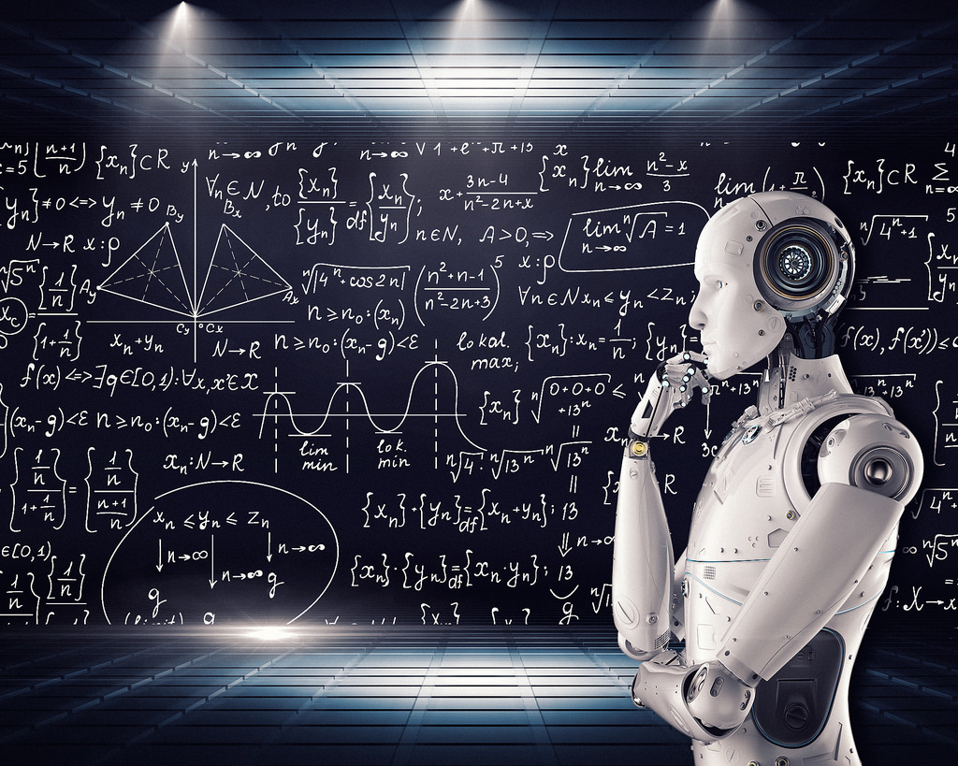




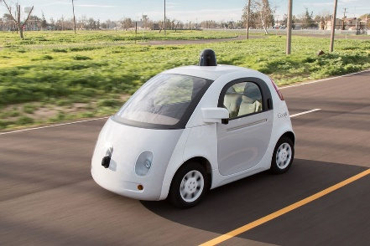

MACHINE LEARNING AND ARTIFICIAL INTELLIGENCE: INTRODUCTION
Artificial Intelligence/Machine learning does not only mean robots or Sci-Fi movies!
Machine learning applications are everywhere!
Google search engine, amazon recommender systems, Facebook facial recognition (tagging), Siri

Slide 2

MACHINE LEARNING AND ARTIFICIAL INTELLIGENCE: PROCESS
Machine learning is the study of algorithms that teach computers to learn from experience.
Through experience (more training data), computers can continuously improve their performance.
STEP 1
STEP 3
STEP 5
Feed training data
Find patterns
Learn from experience
STEP 2
STEP 4
Analyze Data
Perform prediction/Make a decision

Slide 3
MACHINE LEARNING: BIG PICTURE
ARTIFICIAL INTELLIGENCE
Science that enables computers to mimic human intelligence. Subfields: Machine Learning, robotics, and computer vision
MACHINE LEARNING
Subset of AI that enable machines to improve at tasks with experience
SUPERVISED LEARNING
Training algorithms using labeled input/output data.
CLASSIFICATION
REGRESSION
UNSUPERVISED LEARNING
Training algorithms with no labeled data. It attempts at discovering hidden patterns on its own.
CLUSTERING
REINFORCEMENT LEARNING
Algorithm take actions to maximize cumulative reward.

Slide 4
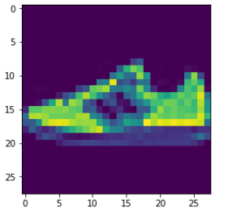
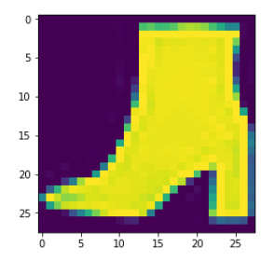
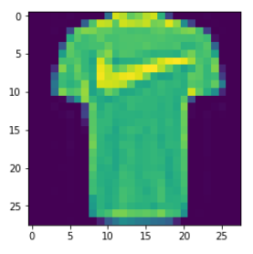
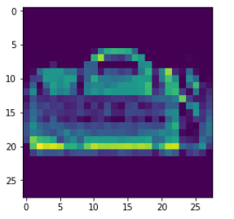

MACHINE LEARNING: SUPERVISED LEARNING
Supervised: used to train algorithms using labeled input and output data.
Performance is assessed by comparing trained model prediction vs. real output.
DESIRED OUTPUT
TARGET CLASSES (LABELS)
y _train
INPUT DATA
$$X _train$$
T-SHIRT/TOP
TROUSER
PULLOVER
DRESS
COAT
SANDAL
SHIRT
SNEAKER
BAG
ANKLE BOOT
MODEL

Slide 5
MACHINE LEARNING: UNSUPERVISED LEARNING
Unsupervised learning: provides the algorithm with no labeled data.
The algorithm attempts at discovering hidden patterns within the training data.
Unsupervised learning methods can analyze complex data that humans might find difficult to interpret.
No feedback!
DATA CLUSTERS
INPUT DATA
MODEL

Slide 6
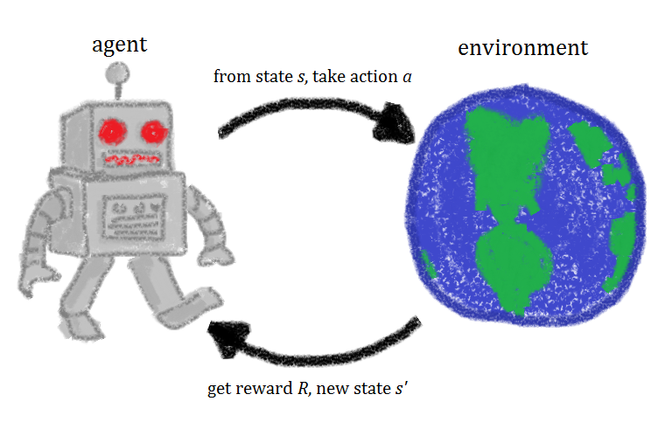

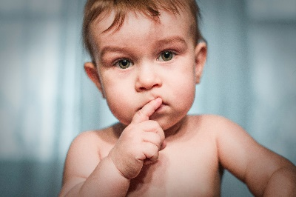

MACHINE LEARNING: REINFORCEMENT LEARNING
Reinforcement learning allows machines take actions to maximize cumulative reward.
Reinforcement algorithms learn by trial and error through reward and penalty.
Two elements: environment and learning agent.
The environment rewards the agent for correct actions.
Based on the reward or penalty, agent improves its environment knowledge to make better decision.
ENVIRONMENT
AGENT
-10 Points
+10 Points
https://commons.wikimedia.org/wiki/File:Rl_agent.png

Slide 7
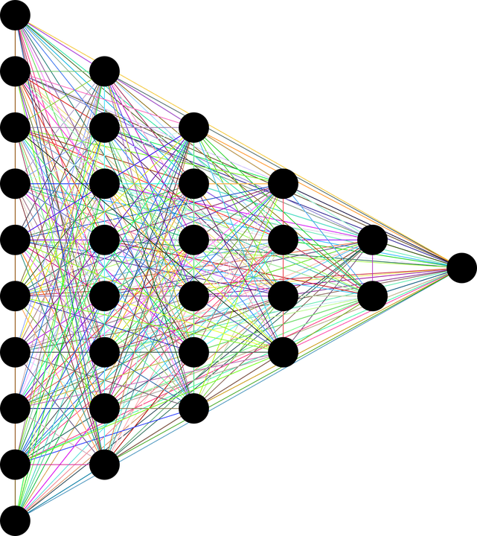
MACHINE LEARNING: DEEP LEARNING
Deep learning is a subset of machine learning that utilizes multi-layer Artificial Neural Networks.
Deep Neural Networks are inspired by the human brain and mimics the operation of biological neurons.
Artificial Intelligence
Machine Learning
Deep Learning
INPUT DATA
TARGET OUTPUTS
Photo Credit: https://pixabay.com/en/neural-network-thought-mind-mental-3816319/
DEEP (HIDDEN LAYERS)

Slide 8
MACHINE LEARNING: WHICH TECHNIQUE SHOULD BE USED?
Classification
Discrete outputs 0,1
Regression
Simple Linear Regression
Polynomial Regression
Clustering
K-Means Clustering
Support Vector Machines
Naïve Bayes
Random forest
K Nearest Neighbours
Logistic regression
Multiple Linear Regression
Predicting continuous values such as temperature
No labelled data
Finding Patterns in data is required
Market segmentation

Slide 9
LOGISTIC REGRESSION: CONFUSION MATRIX
TRUE CLASS
+
-
TYPE I ERROR
+
TRUE +
FALSE +
PREDICTIONS
-
FALSE -
TRUE -
TYPE II ERROR

Slide 10
LOGISTIC REGRESSION: CONFUSION MATRIX
TRUE CLASS
+
-
True Positives (TP)
True Negatives (TN)
False Positives (FP)
False Negatives (FN)
TYPE I ERROR
+
True Positives
(TP) = 30
FALSE Positives
(FP) = 20
Total Data points = 105
PREDICTIONS
Accuracy = (TP+TN)/Total
Accuracy = 80/105=0.76
-
FALSE Negatives
(FN) = 5
TRUE Negatives
(TN) = 50
TYPE II ERROR

Slide 11

LOGISTIC REGRESSION: INTUITION
Linear regression is used to predict outputs on a continuous spectrum.
Example: predicting revenue based on the outside air temperature.
Logistic regression is used to predict binary outputs with two possible values labeled "0" or "1"
Logistic model output can be one of two classes: pass/fail, win/lose, healthy/sick
Hours Studying | Pass/Fail
1 | 0
1.5 | 0
2 | 0
3 | 1
3.25 | 0
4 | 1
5 | 1
6 | 1
PASS/FAIL
LINEAR MODEL
HOURS OF STUDYING

Slide 12
LOGISTIC REGRESSION: INTUITION
Linear regression is not suitable for classification problem.
Linear regression is unbounded, so logistic regression will be better candidate in which the output value ranges from 0 to 1.
LINEAR MODEL
PASS/FAIL
LOGISTIC REGRESSION MODEL
HOURS OF STUDYING

Slide 13
LOGISTIC REGRESSION: SOME MATH
Logistic regression algorithm works by implementing a linear equation first with independent predictors to predict a value.
We then need to convert this value into a probability that could range from 0 to 1.
Linear equation:
$y=b_{0}+b_{1}∗x$
Apply Sigmoid function:
$P\left(x\right)= sigmoid \left(y\right)$
$P\left(x\right)=\frac{1}{1+e^{−y}}$
$P\left(x\right)=\frac{1}{1+e^{−(b_{0}+b_{1}∗x)}}$
PASS/FAIL
LOGISTIC REGRESSION MODEL
HOURS OF STUDYING

Slide 14
LOGISTIC REGRESSION: FROM PROBABILITY TO CLASS
Now we need to convert from a probability to a class value which is “0” or “1”.
Linear equation:
$y=b_{0}+b_{1}∗x$
Apply Sigmoid function:
$P\left(x\right)= sigmoid \left(y\right)$
$P\left(x\right)=\frac{1}{1+e^{−y}}$
Class 1
LOGISTIC REGRESSION MODEL
PASS/FAIL
0.5
Class 0
THRESHOLD
HOURS OF STUDYING

Slide 15
SUPPORT VECTOR MACHINES: INTUITION
Assume that you are data scientist working at a major bank in NYC.
You want to classify a new client as eligible to retire or not, customer features are: Age and Savings.
SUPPORT VECTORS
FEATURE #2: SAVINGS
MAXIMUM MARGIN
MAX MARGIN
HYPERPLANE
FEATURE #1: AGE

Slide 16
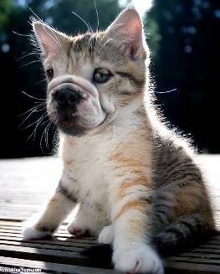

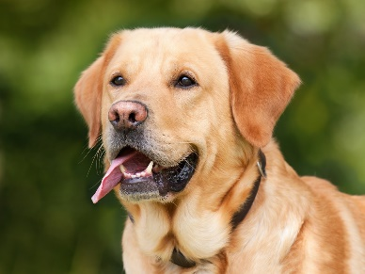
SUPPORT VECTOR MACHINES: INTUITION
FEATURE #2
FEATURE #1

Slide 17
SUPPORT VECTOR MACHINES: MODEL EVALUATION
TRAINED MODEL
(MAX MARGIN
HYPERPLANE)
FEATURE #2
TESTING DATASET
FEATURE #1

Slide 18
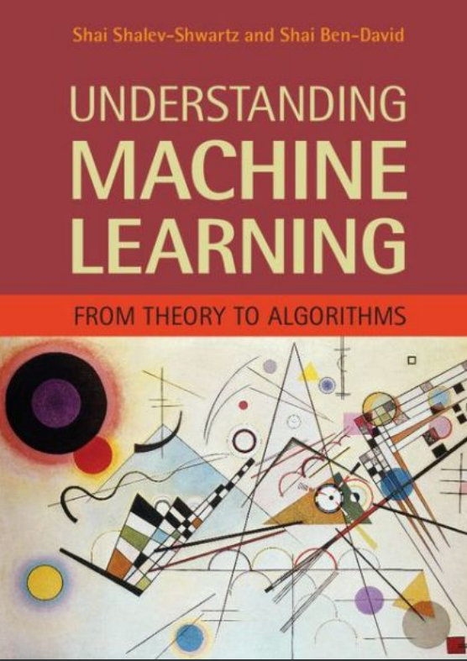
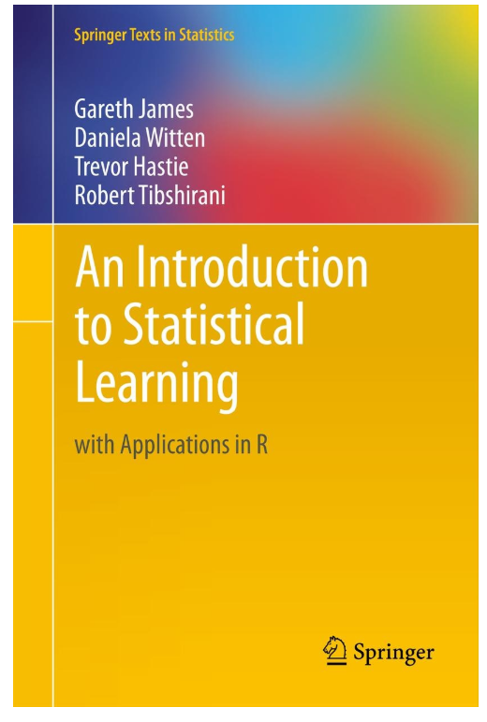
SUPPORT VECTOR MACHINES: ADDITIONAL READING MATERIAL
Additional Resources, Page #202: http://www.cs.huji.ac.il/~shais/UnderstandingMachineLearning/understanding-machine-learning-theory-algorithms.pdf
Additional Resources, Page #337:
http://www-bcf.usc.edu/~gareth/ISL/ISLR%20Seventh%20Printing.pdf

Slide 19
SUPPORT VECTOR MACHINES: GENERALIZATION INTUITION
GENERALIZED
MODEL
FEATURE #2
OVERFITTED
MODEL
FEATURE #1

Slide 20
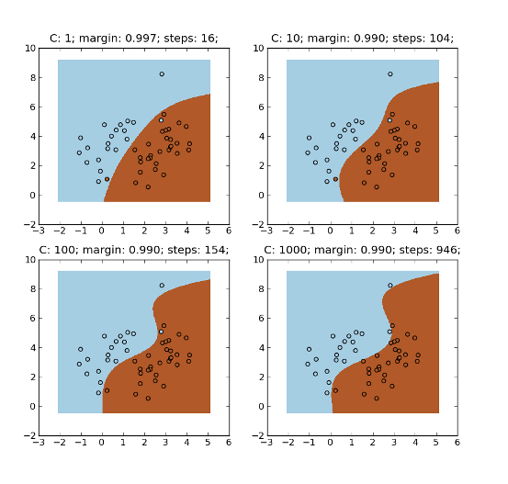
SUPPORT VECTOR MACHINES: PARAMETERS OPTIMIZATION
C parameter: Controls trade-off between classifying training points correctly and having a smooth decision boundary
Small C (loose) makes cost (penalty) of misclassification low (soft margin)
Large C (strict) makes cost of misclassification high (hard margin), forcing the model to explain input data stricter and potentially over fit.
FEATURE #2
FEATURE #1
http://mlpy.sourceforge.net/docs/3.4/svm.html

Slide 21
SUPPORT VECTOR MACHINES: PARAMETERS OPTIMIZATION
Gamma parameter: controls how far the influence of a single training set reaches
Large gamma: close reach (closer data points have high weight)
Small gamma: far reach (more generalized solution)
s$mall γ$
Large $γ$
FEATURE #2
IGNORED!
FEATURE #1

Slide 22


K NEAREST NEIGHBORS (KNN): INTUITION
k-nearest neighbors algorithm (KNN) is a classification algorithm.
KNN works by finding the most similar data points in the training data, and attempt to make an educated guess based on their classifications.
SIZE: SMALL
SIZE: LARGE
HEIGHT (CMS)
L
150 160 170 180
S
?
55 60 65 70
WEIGHT (KGS)

Slide 23
K NEAREST NEIGHBORS (KNN): ALGORITHM STEPS
Select a value for k (e.g.: 1, 2, 3, 10..)
Calculate the Euclidian distance between the point to be classified and every other point in the training data-set
Pick the k closest data points (points with the k smallest distances)
Run a majority vote among selected data points, the dominating classification is the winner! Point is classified based on the dominant class.
Repeat!

Slide 24
EUCLIDEAN DISTANCE: INTUITION
$$Euclidean Distance= \sqrt{{\left(x_{2}−x_{1}\right)}^{2}+{\left(y_{2}−y_{1}\right)}^{2}}$$
$y_{2}$
$Point B {(x}_{2}, y_{2})$
$y_{1}$
$Point A {(x}_{1}, y_{1})$
$x_{1}$
$x_{2}$

Slide 25
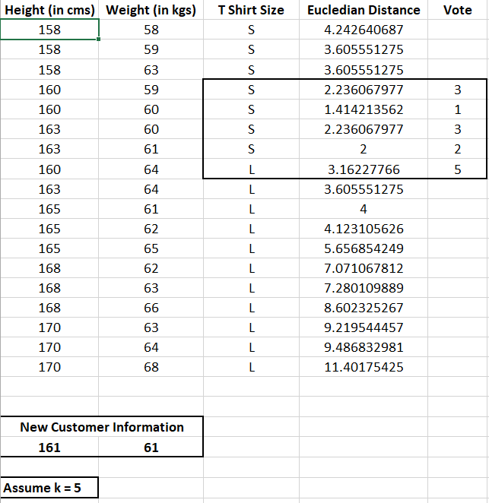
K NEAREST NEIGHBORS (KNN): EXAMPLE
KNN will look for the 5 data points that are closest to the new customer data point
The algorithm will determine which category (class) are these 5 points in.
Since 4 points had class ‘Small’ and 1 had ‘Large’, then new customer shall be assigned Small size.
L
S
https://www.listendata.com/2017/12/k-nearest-neighbor-step-by-step-tutorial.html

Slide 26
K NEAREST NEIGHBORS (KNN): EXAMPLE
Let’s understand this example visually!
SIZE: SMALL
HEIGHT (CMS)
SIZE: LARGE
L
150 160 170 180
S
POINT CLASSIFIED AS BLUE (S SIZE)
?
55 60 65 70
WEIGHT (KGS)

Slide 27
DECISION TREES: INTUITION
Decision Trees are supervised Machine Learning technique where the data is split according to a certain condition/parameter.
Let’s assume we want to classify whether a customer could retire or not based on their savings and age.
Savings>$1M
AGE
Yes
No
45 years
Age > 45?
Class #0
Yes
No
Class #1
Class #0
$1 Million
SAVINGS

Slide 28
DECISION TREES: DEFINITIONS
The tree consists of decision nodes and leaves.
Leaves are the decisions or the final outcomes.
Decision nodes are where the data is split based on a certain attribute.
Objective is to minimize the entropy which provides the optimum split
DECISION NODES
Savings>$1M
Yes
No
Age > 45?
Class #0
Yes
No
LEAVES
Class #1
Class #0

Slide 29
DECISION TREES: CUSTOMER SEGMENTATION
Credit Score<750
CREDIT SCORE
Yes
No
Income<$200K
Income<$100K
750
Yes
No
Yes
No
650
Class #1
Credit Score<650
Class #0
Class #1
Yes
No
$100K
$200K
INCOME
Class #0
Class #1

Slide 30
DECISION TREES: ADDITIONAL READING MATERIAL
Additional Resources, Page #250: http://www.cs.huji.ac.il/~shais/UnderstandingMachineLearning/understanding-machine-learning-theory-algorithms.pdf
Additional Resources, Page #303:
http://www-bcf.usc.edu/~gareth/ISL/ISLR%20Seventh%20Printing.pdf

Slide 31
RANDOM FOREST: INTUITION
Random Forest Classifier is a type of ensemble algorithm.
It creates a set of decision trees from randomly selected subset of training set.
It then combines votes from different decision trees to decide the final class of the test object.
TREE #1
TREE #2
TREE #N
Savings>$1M
Savings>$1M
Savings>$1M
Yes
No
Yes
No
Yes
No
Age > 45?
Class #0
Age > 45?
Class #0
Age > 45?
Class #0
Yes
No
Yes
No
Yes
No
Class #1
Class #0
Class #1
Class #0
Class #1
Class #0
OUT = CLASS #1
OUT = CLASS #1
OUT = CLASS #0
MAJORITY VOTE = CLASS #1

Slide 32
RANDOM FOREST: WHY AND HOW?
It overcomes the issues with single decision trees by reducing the effect of noise.
Overcomes overfitting problem by taking average of all the predictions, canceling out biases.
Suppose training set: [X1, X2, X3, X4] with labels: [L1, L2, L3, L4]
Random forest creates three decision trees taking inputs as follows:
[X1, X2, X3], [X1, X2, X4], [X2, X3, X4]
Example: Combining votes from a pool of experts, each will bring their own experience and background to solve the problem resulting in a better outcome.
Complete Training set
Training
set #1
Training
set #2
Training
set #3
Decision Tree #1
Decision Tree #2
Decision Tree #3
VOTING

Slide 33
RANDOM FOREST: ADDITIONAL READING MATERIAL
Additional Resources, Page #255: http://www.cs.huji.ac.il/~shais/UnderstandingMachineLearning/understanding-machine-learning-theory-algorithms.pdf
Additional Resources, Page #320:
http://www-bcf.usc.edu/~gareth/ISL/ISLR%20Seventh%20Printing.pdf

Slide 34
NAÏVE BAYES: INTUITION
Naïve Bayes is a classification technique based on Bayes’ Theorem.
Let’s assume that you are data scientist working major bank in NYC and you want to classify a new client as eligible to retire or not.
Customer features are his/her age and salary.
CLASS 1: RETIRE
40 BLUE POINTS
NEW CUSTOMER
FEATURE #2: SAVINGS
?
CLASS 0: NO RETIRE
20 RED POINTS
FEATURE #1: AGE

Slide 35
CLASS 1: RETIRE
NAÏVE BAYES: 1. PRIOR PROBABILITY
40 BLUE POINTS
Points can be classified as RED or BLUE.
Our task is to classify a new point to RED or BLUE.
Prior Probability: Since we have more BLUE compared to RED, we can assume that our new point is twice as likely to be BLUE than RED.
FEATURE #2: SAVINGS
$$Prior Probability for RED=\frac{Number of RED Points}{Total Number of Points}=\frac{20}{60}$$
?
CLASS 0: NO RETIRE
$$Prior Probability for BLUE=\frac{Number of BLUE Points}{Total Number of Points}=\frac{40}{60}$$
20 RED POINTS
FEATURE #1: AGE

Slide 36
NAÏVE BAYES: 2. LIKELIHOOD
40 BLUE POINTS
For the new point, if there are more BLUE points in its vicinity, it is more likely that the new point will be classified as BLUE.
So we draw a circle around the point
Then we calculate the number of points in the circle belonging to each class label.
FEATURE #2: SAVINGS
$$Likelihood of X being RED=\frac{Number of RED Points in vicinity }{Total Number of RED Points}=\frac{3}{20}$$
?
$$Likelihood of X being BLUE=\frac{Number of BLUE Points in vicinity }{Total Number of BLUE Points}=\frac{1}{40}$$
20 RED POINTS
FEATURE #1: AGE

Slide 37
40 BLUE POINTS
NAÏVE BAYES: 3. POSTERIOR PROBABILITY
Let’s combine prior probability and likelihood to create a posterior probability.
Prior probabilities: suggests that X may be classified as BLUE Because there are twice as much blue points.
Likelihood: suggests that X is RED because there are more RED points in the vicinity of X.
Bayes’ Rule combines both to form a posterior probability.
FEATURE #2: SAVINGS
?
$$Posterior Probability of X being RED= Prior Probability of RED ∗Likelihood of X being RED=\frac{20}{60}∗\frac{3}{20}=\frac{1}{20}$$
20 RED POINTS
FEATURE #1: AGE
$$Posterior Probability of X being BLUE= Prior Probability of BLUE∗Likelihood of X being BLUE=\frac{40}{60}∗\frac{1}{40}=\frac{1}{60}$$
X CLASSIFIED AS RED (NON RETIRING) SINCE IT HAS LARGER POSTERIOR PROBABILITY

Slide 38
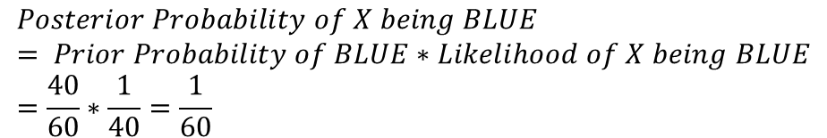
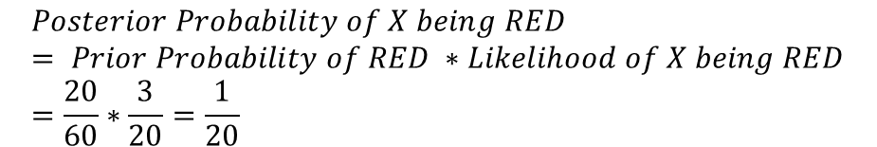
40 BLUE POINTS
NAÏVE BAYES: REVIEW
Let’s combine prior probability and likelihood to create a posterior probability.
Prior probabilities: suggests that X may be classified as BLUE Because there are twice as much blue points.
Likelihood: suggests that X is RED because there are more RED points in the vicinity of X.
Bayes’ Rule combines both to form a posterior probability.
FEATURE #2: SAVINGS
?
$$Posterior Probability of X being RED= Prior Probability of RED ∗Likelihood of X being RED=\frac{20}{60}∗\frac{3}{20}=\frac{1}{20}$$
20 RED POINTS
FEATURE #1: AGE
$$Posterior Probability of X being BLUE= Prior Probability of BLUE∗Likelihood of X being BLUE=\frac{40}{60}∗\frac{1}{40}=\frac{1}{60}$$
X CLASSIFIED AS RED (NON RETIRING) SINCE IT HAS LARGER POSTERIOR PROBABILITY

Slide 39


NAÏVE BAYES: SOME MATH!
Naïve Bayes is a classification technique based on Bayes’ Theorem.
PRIOR PROBABILITY OF RETIRING
LIKELIHOOD
$$P\left(Retire\right|X)=\frac{P\left(X | Retire\right)∗P(Retire)}{P(X) }$$
MARGINAL LIKELIHOOD
$X$: New Customer’s features; age and savings
$P\left(Retire\right|X)$: probability of customer retiring given his/her features, such as age and savings
$P(Retire)$: Prior probability of retiring, without any prior knowledge
$P(X|Retire)$: likelihood
$P(X)$: Marginal likelihood, the probability of any point added lies into the circle

Slide 40

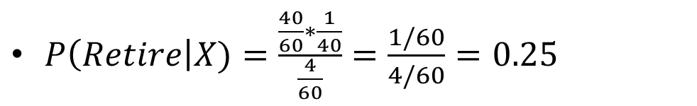
NAÏVE BAYES: SOME MATH!
PRIOR PROBABILITY OF RETIRING
LIKELIHOOD
CLASS 1: RETIRE
40 BLUE POINTS
$$P\left(Retire\right|X)=\frac{P\left(X | Retire\right)∗P(Retire)}{P(X) }$$
FEATURE #2: SAVINGS
MARGINAL LIKELIHOOD
$P\left(Retire\right)=\frac{\# of Retiring}{Total points}= 40/60$
?
$P\left(X | Retire\right)=\frac{\# of smilar observations for retiring}{Total \# retiring}=1/40$
CLASS 0: NO RETIRE
$P\left(X\right)=\frac{\# of Similar observations}{Total \# Points}=4/60$
20 RED POINTS
$P\left(Retire\right|X)=\frac{\frac{40}{60}∗\frac{1}{40}}{\frac{4}{60}}=\frac{1/60}{4/60}=0.25$
FEATURE #1: AGE

Slide 41
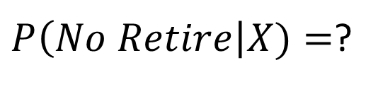
NAÏVE BAYES: QUIZ/CALCULATE THE PROBABILTY OT NON-RETIRING (RED CLASS)
$P\left(No Retire\right|X)=$?

Slide 42

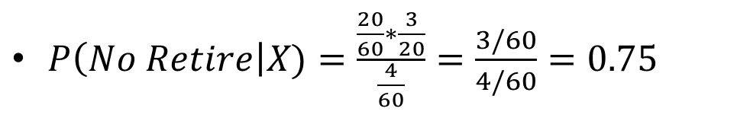
NAÏVE BAYES: QUIZ/CALCULATE THE PROBABILTY OT NON-RETIRING (RED CLASS)
PRIOR PROBABILITY OF NO RETIRING
CLASS 1: RETIRE
LIKELIHOOD
40 BLUE POINTS
$$P\left(No Retire\right|X)=\frac{P\left(X | No Retire\right)∗P(No Retire)}{P(X) }$$
FEATURE #2: SAVINGS
MARGINAL LIKELIHOOD
$P\left(No Retire\right)=\frac{\# of No Retiring}{Total points}=20/60$
$P\left(X | No Retire\right)=\frac{\# of smilar observations for No retiring}{Total \# no retiring}=3/20$
?
$P\left(X\right)=\frac{\# of Similar observations}{Total \# Points}=4/60$
CLASS 0: NO RETIRE
$P\left(No Retire\right|X)=\frac{\frac{20}{60}∗\frac{3}{20}}{\frac{4}{60}}=\frac{3/60}{4/60}=0.75$
20 RED POINTS
FEATURE #1: AGE
$$NOTE: P\left(Non Retire\right|X)=1−0.25=0.75$$

Slide 43
NAÏVE BAYES: WHY NAÏVE?
CLASS 1: RETIRE
40 BLUE POINTS
It is called naive because it assumes that the presence of a certain feature in a class is independent of the presence of other features.
EXAMPLE #1: Age/savings, the assumption is not necessarily true since age and savings might be dependant on each others
EXAMPLE #2: fruit can be classified as watermelon if its color is green, tastes sweet, and round.
These features might be dependant on each others, however, we assume they are all independent and that’s why its ‘Naive’!
FEATURE #2: SAVINGS
?
CLASS 0: NO RETIRE
20 RED POINTS
FEATURE #1: AGE

